Slide 1
Bethy_Craft Delivery and Customer Behaviour Analysis
PROJECT OVERVIEW
This project is to analyze customer purchasing patterns, warehouse performance,shipment preferences and revenue contribution to understand what drives business growth.

Slide 2
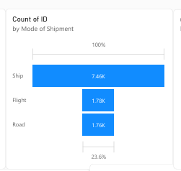
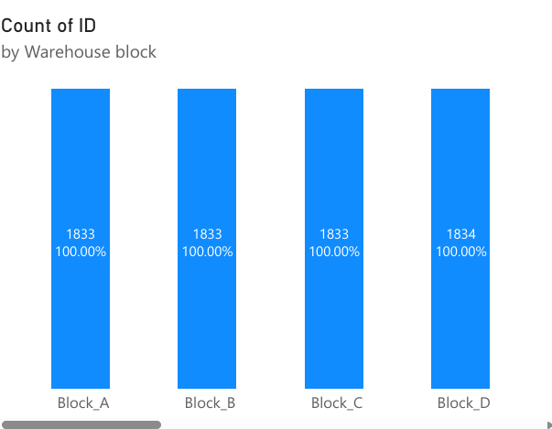
Orders are evenly distributed across all the warehouse blocks but block e has the highest orders ship is the dominant shipment mode

Slide 3
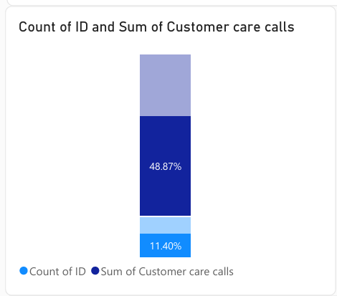
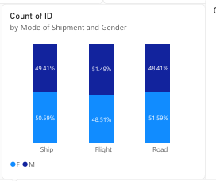
Total customer care calls is higher than total orders
Gender distribution is balanced across all shipment mode

Slide 4
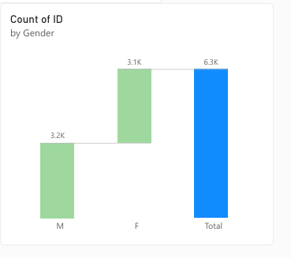
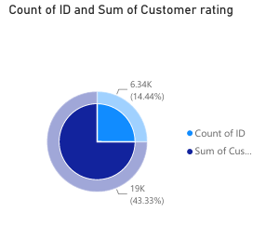
Male customers slightly outnumber female customers
Sum of customer ratings outweighs total order count

Slide 5
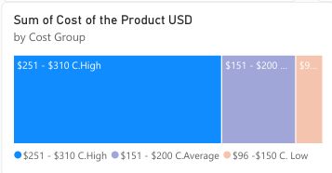
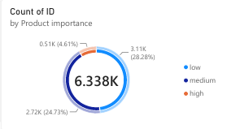
The high cost group($251-$310)contributes the highest total revenue despite similar order count
Low-importance products dominate sales at 49%

Slide 6
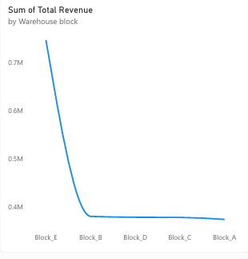
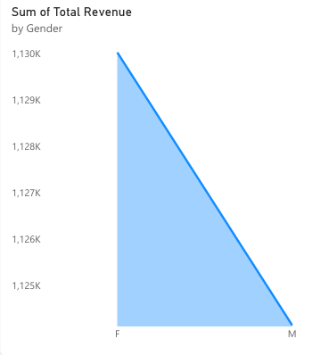
Block e generates the highest revenue which is double the revenue of other block.
Female customers generate slightly higher revenue than male customers

Slide 7
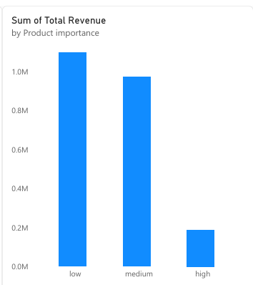
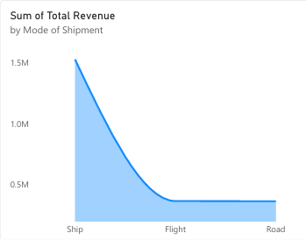
Ship mode generates the highest revenue more than four times the revenue from road and and flight low importance products generates the highest revenue.

Slide 8
CONCLUSION
This analysis of 10,999orders reveals that business performance is not driven by product importance, but by cost and logistics.

